Slide 1

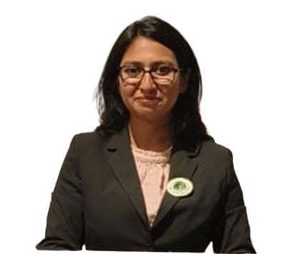

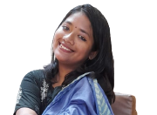
Team Max Fresh
Debosree Roy
Kesiraju Lokesh
Drisha Paul
Himalaya Wellness
HUL
Nestle

Slide 2









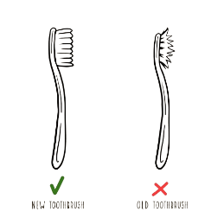
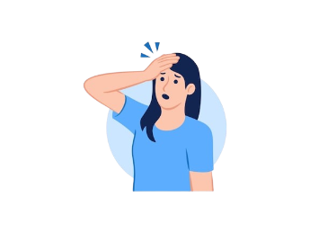
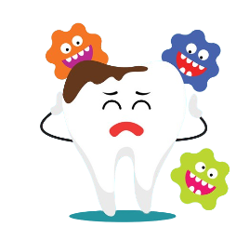


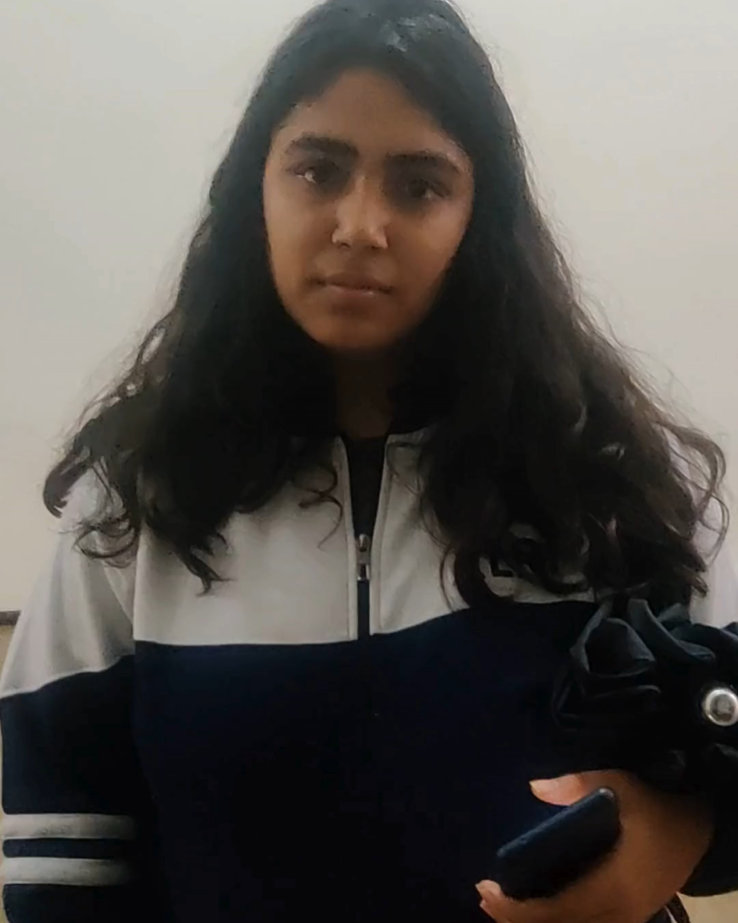


Aim is to drive habit change though increased purchase involvement aided by COLGATE SHADES..
Throw your old toothbrush after three months or when the bristles start to flare, whichever comes first. IDA
Consumer insights
We conducted a survey across a cohort of 256 people regarding their oral hygiene awareness and preference
What matters to the consumers
How frequently is toothbrush changed?
Respondent category
Why is toothbrush changed?
Gender
Dentist advice
Brand
Bristle texture
Brush head
Availability
Past experience
124
132
Age
50%
62%
88%
36%
82%
74%
18-25
51%
40-55
5%
Consumer journey
25-32
28%
>55
3%
32-40
13%
Consumer purchasing a single toothbrush
Using the toothbrush for too long
Geography
User forgetting/ignoring replacement
Oral problems emerging
Tier 1
Tier 2
Tier 3
53%
36%
11%
Why the low replacing frequency
Key barriers to chanege
Awareness
Culture
Only 38% Indian adults are aware about the replacement frequency
The culture of sharing toothbrush is predominant, with 42% Indians sharing toothbrushes
Barrier
Intensity
Average Indian frequency of toothbrush replacement: 5.4 months
No visible change
No change in brushing experience
Habitual behaviour
Visible cues
No awareness of health problems
Habituated with using same toothbrush for long: only 28% frequently change their brushes
Facing no visible oral issues due to non-replacement of brush: 40% Indians claim to face no visible issues
Lack of knowledge in media
Laziness to go and purchase
Consumer insight clip
Problem statement
Consumer insights
Rationale
Narrative change
Product innovation
Communication strategy
Points of purchase
Key financials

Slide 3





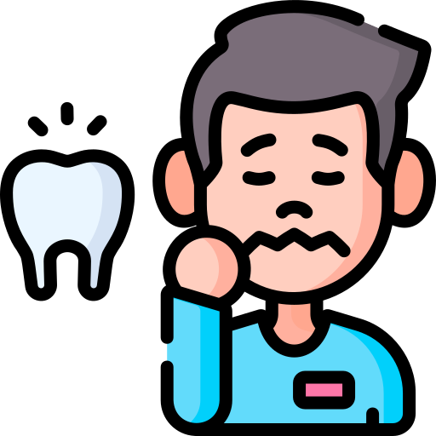
Customer segmentation is done in order to find out key influencers..
Customer persona
we have used typical buyer personas to create customer segmentation to find out the ease of change
Target consumer
Purchase frequency
Mode of purchase
Willingness to change
Major barriers
Consumer segmentation
Order of change
Arun, daily wage labourer
Rare, when damaged
Local kirana
Cost, hygiene not imp
Informed sceptics
Ready adopters
Need nudge to change. Use expert advice to convince. Emphasize on ease to convert
HIGH
They are the trendsetters. Potential to be influencers. Easiest to convert. Highlight overall benefit
Ready adopter
Malini,CA, mother of 2, aged 4 & 6
Once in 6 months
Supermarket,
lack of credible information
Asha, lawyer, lives in joint family
Twice in a 15 months
Mostly online
Indifferent, mult. purchase inconvenient
Informed sceptic
Rahul, journalist, lives alone, health conscious
Half yearly Uses electric brush
Not fixed
Lack of endorsement by dentist
Awareness
Willingness to change
LOW
HIGH
Ignorants
Explorers
Explorers
Major barriers
indifference
Lack of credible information
inconvinience
Barriers to conversion highest. Education is key. Price point imp. Simplify communication
Attractive communication is key.
Key insights
LOW
Ignorants
Consumer
influence
decisionmaker
Influence
Children <5 years
None
Mothers/ parents
Dentist, reliable source
Key Insights
Teens
peers, advertisement, social media
Mothers/ parents
Dentist, reliable source
Consumers and buyers are not the same, especially in the younger age group. Hence the targeted behaviour change should be towards the key decision makers
Adults
advertisement, brand loyalty, print media, dentist
Consumer themselves
advertisement, brand loyalty, print media, dentist
Communication towards mothers, major decision maker in the Indian household
Dental experts and other key subject matter experts are key influencers
Orthodontic patients
Dentist and past experience
Consumer themselves
Dentist and past experience
Problem statement
Consumer insights
Rationale
Narrative change
Product innovation
Communication strategy
Points of purchase
Key financials

Slide 4

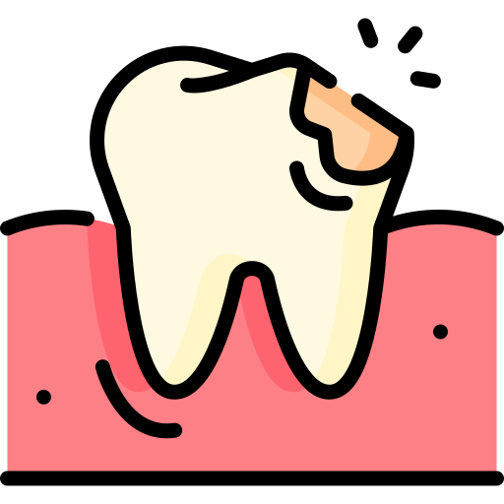







Aim is to drive habit change though increased purchase involvement aided by COLGATE SHADES..
Elements to drive change
Increasing purchase involvement
Current State
Current scenario
Existing habit
Lack of awareness
Consumer indifferent to quality of brush. Toothbrush is a low involvement and impulse purchase product. Consumer buys new product when old one beyond recovery
People don’t change their toothbrush until they see major visible change
No visible cue
WHY?
Laziness
No visible effect in health. Nobody talks about how frequently to change toothbrush
No visible benefit
Problem creation
Lack of external pressure
Tooth decay/ailment
Using risk communication and social exclusion fear to establish the problem statement
Product innovation
Building the new narrative
Problem awareness
Colour changing toothbrush to tell the consumer that it is time to change the toothbrush
Colgate SHADES is the new product
Through external reinforcement
Behaviour change oriented campaigns
Using communication under tagline BADAAL DAALO to generate the buzz, without directly promoting COLGATE
Increased cost due to dentist visits
Generating solution
Proposing a solution through COLGATE SHADES to nudge consumer to increase their purchase involvement. Marketing interventions to popularize product
Shift consumer to buying COLGATE SHADES. In long term the idea is consumer changes every Colgate toothbrush they use
Desired state
Make toothbrush a social norm like brushing twice in a day. One feels ashamed to go out and interact if they don’t subscribe to this norm
“ Mom, all my friends keep buying new fancy toothbrush. I have been using the same one for the last 1 year. Please buy me a new one “
Habit change
Social exclusion
Habit change not through pushing the product colgate SHADES, but to make consumers increase purchase frequency
What is the role of Colgate in the behaviour change?
How are we building the narrative change?
Building Awareness
Product innovation
Changing habit
Social norm
Problem statement
Consumer insights
Rationale
Narrative change
Product innovation
Communication strategy
Points of purchase
Key financials

Slide 5






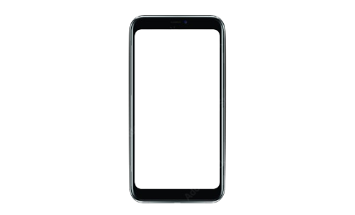

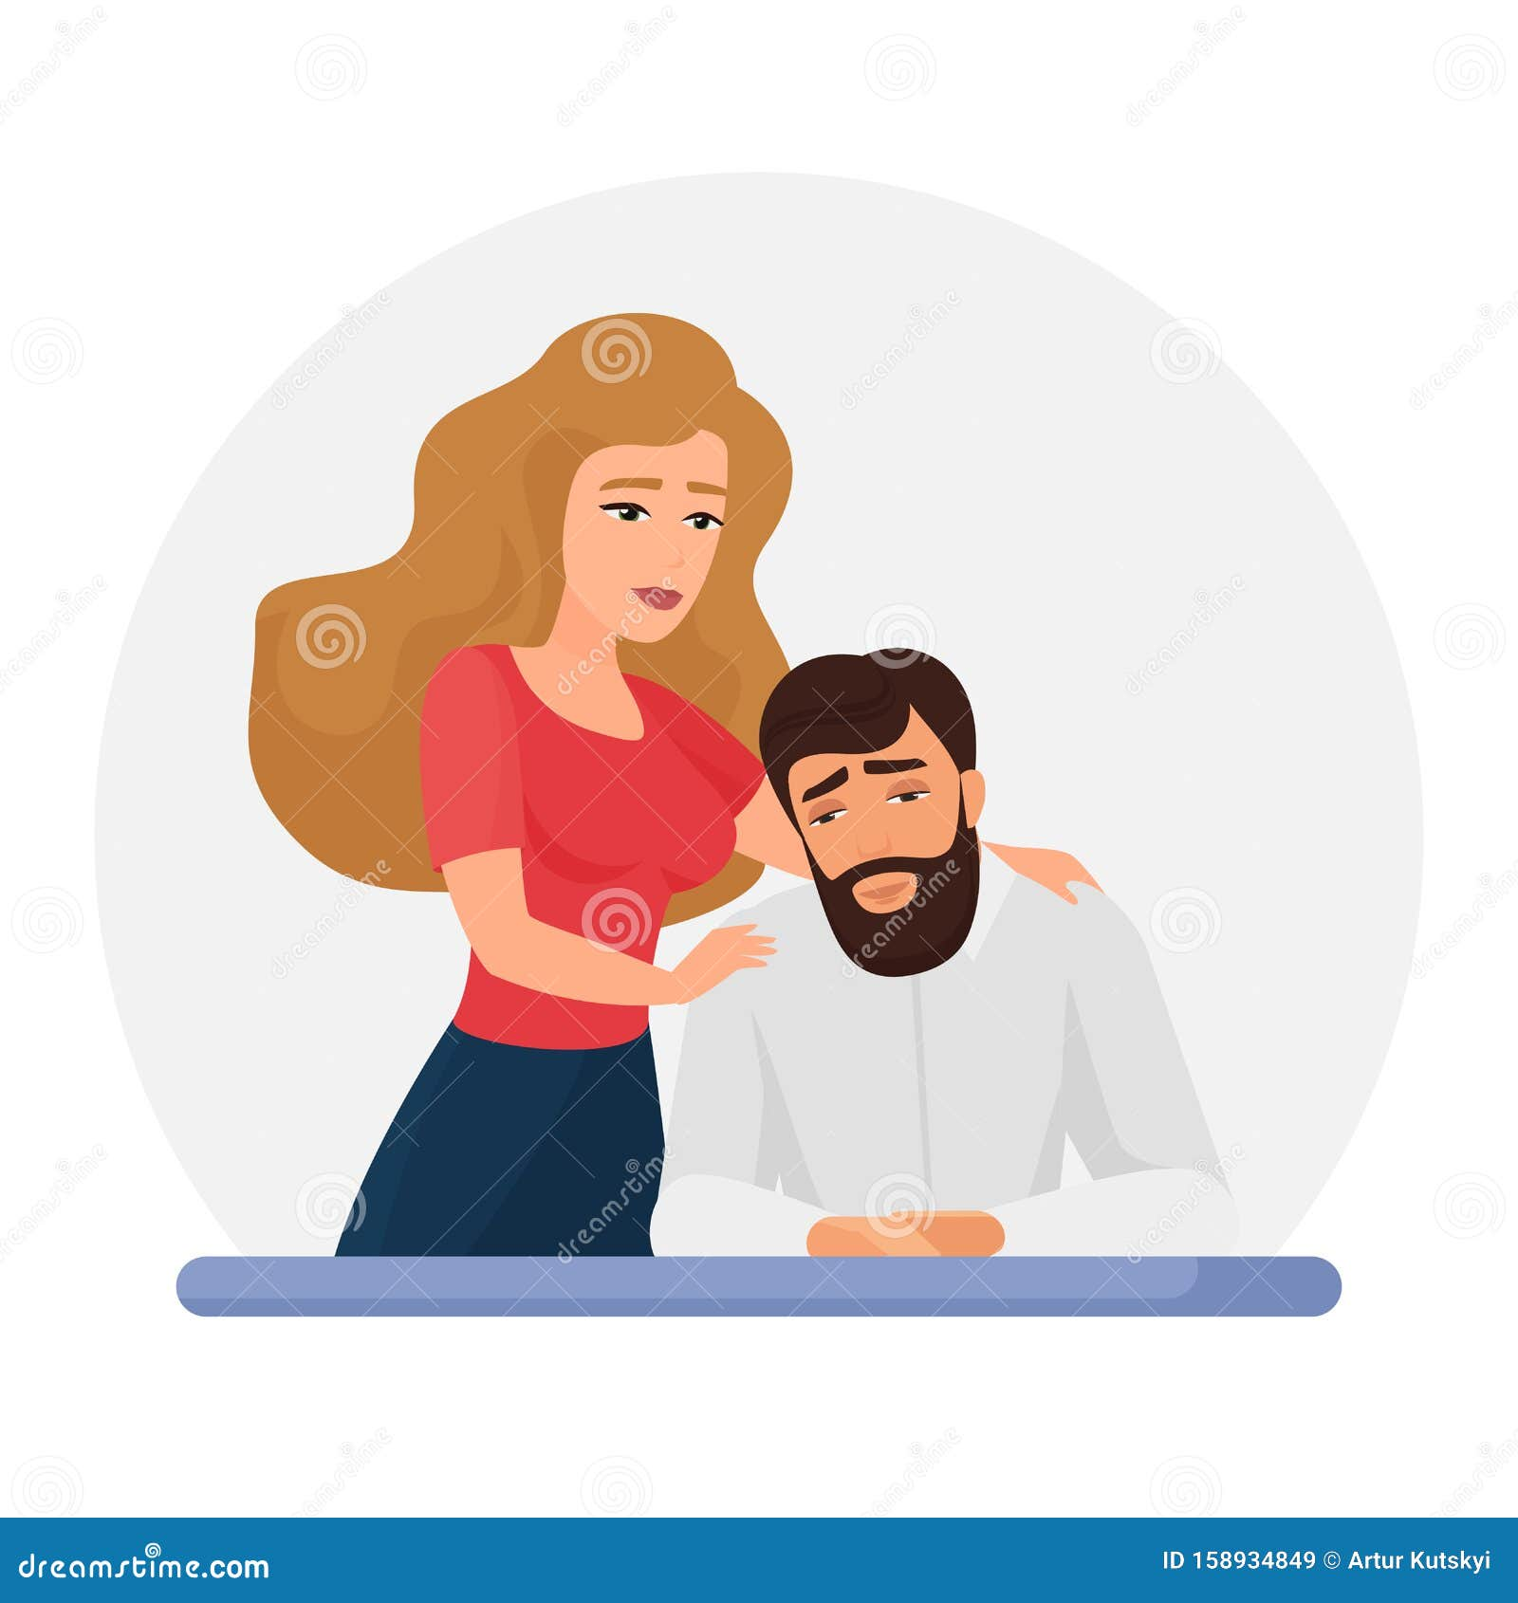
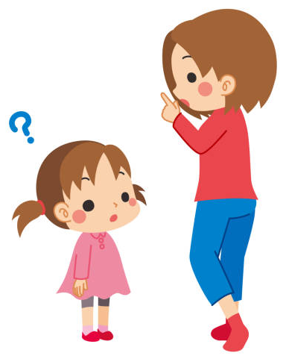
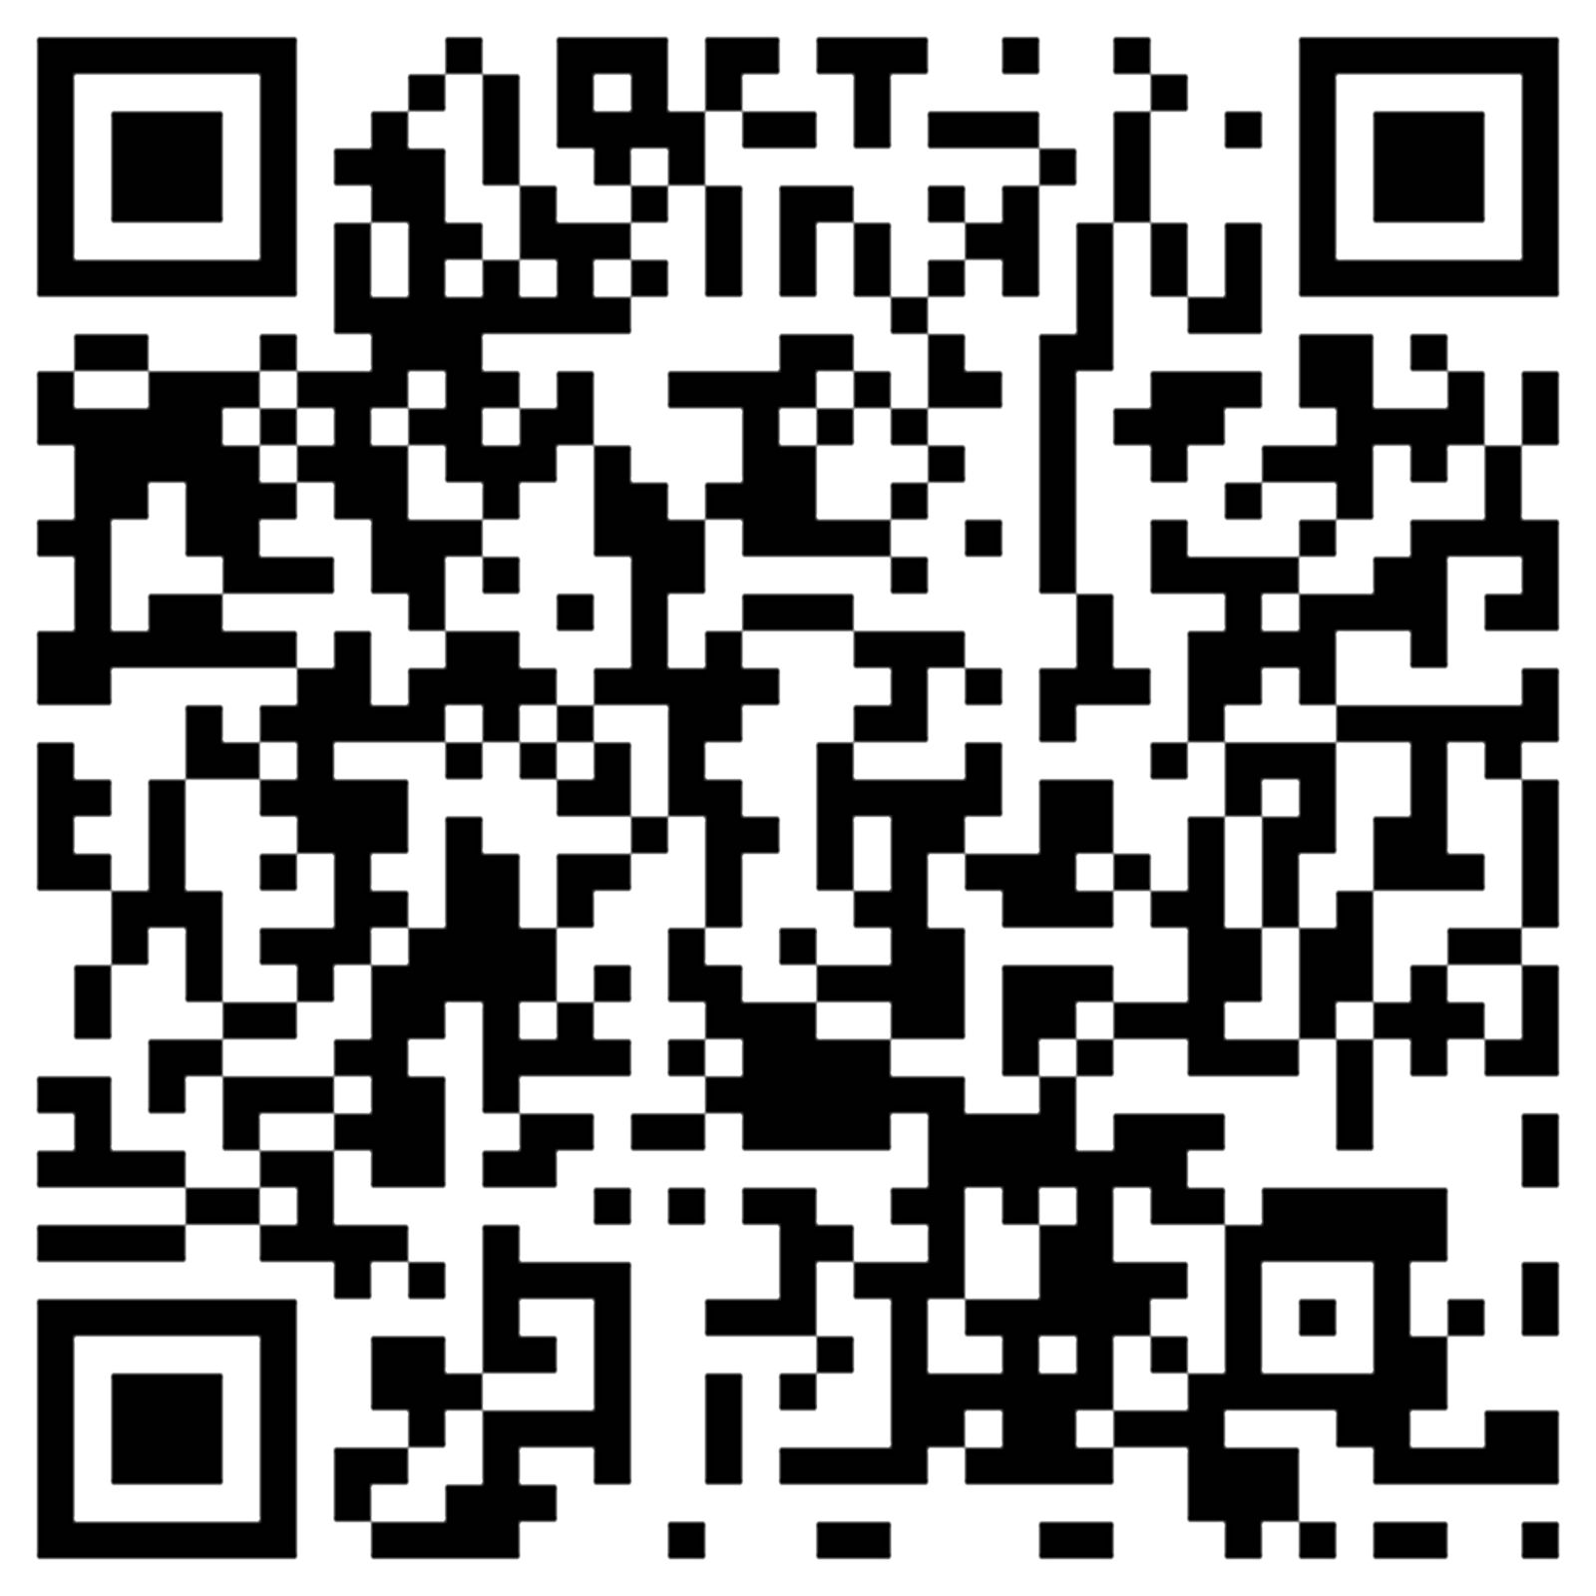


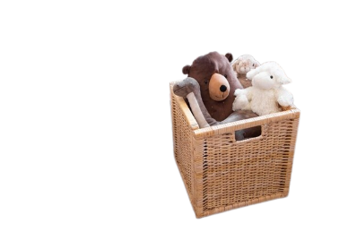




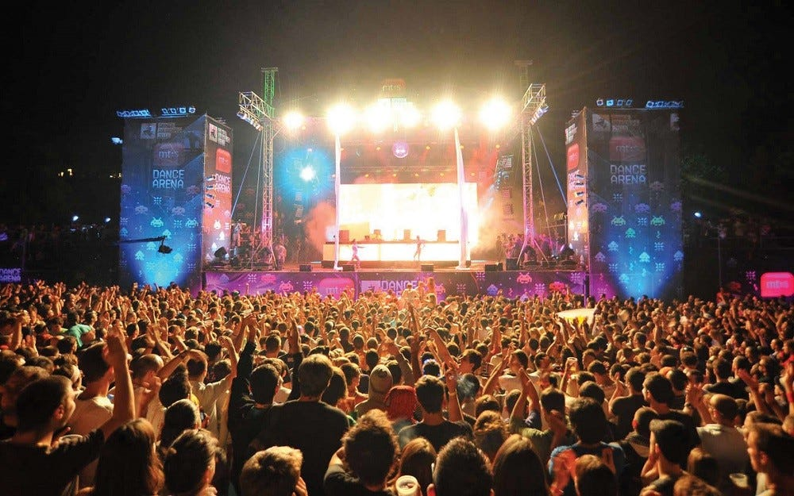
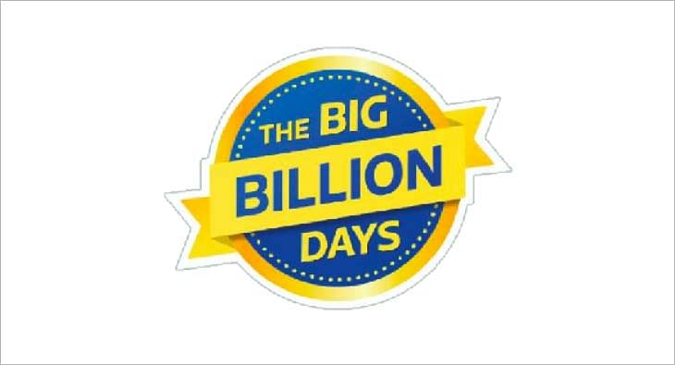


Narrative change is the first step towards bringing about the desired habit change through BADAAL daalo ..
Behaviour change through
1. Narrative change
2. Product innovation
Generating the BUZZ “BADAL DAALO”
Popularizing BADAL DAALO
Reinforcing BADAL DAALO
1
Office colleagues asking “Badla Kya?”
School friends asking “Badla Kya?”
A
Targeted communication
1
+
Be kiss ready: Collaborate with Tinder to promote oral hygiene
1
+
[expert opinion]
Wife asking husband “Badla Kya?”
Mother asking children “Badla Kya?”
WHO
WHY
Gen z, millennials
Making oral health a part of social norm
Everyone asks “Are kya badla?”, to which all answer “Are TOOTHBRUSH BADLA KYA? NAHI BADLA TO BADAL DALO!”
2
+
Tie-up with semi-urban and rural schools to promote awareness about oral hygiene among children
Redirect to a pop-up with expert opinion to raise awareness
Mystery QR code to generate curiosity
Educated consumers. Primarily the urban audience
Involves all consumer segments
WHO
WHY
WHO
WHY
School students
Awareness at root level
2
2
Blank billboards with only tagline to generate curiosity
WHO
+
Road displays: ask people to pick up stuff using crooked hook, that resonate with frayed bristles not being able to clean plague
ATL for wider reach
3
Collaborate with period tracking apps to send reminders. To reiterate the idea of periodic checking
WHY
WHO
WHY
Link through font used
Working women, homemakers
Association of periodic checking
3
+
Fun Friday on Insta:
A fun fact/ quiz on the Colgate insta page every Friday at the same time under “BADAAL DAALO”
SUBLIMINAL ASSOCIATION
+
Brand trust
Similar font association
Popularising product during festivals & fests
Problem statement
Consumer insights
Rationale
Narrative change
Product innovation
Communication strategy
Points of purchase
Key financials

Slide 6
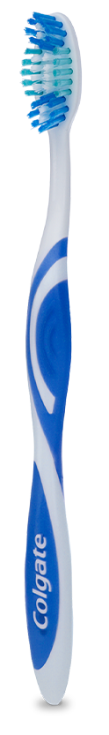
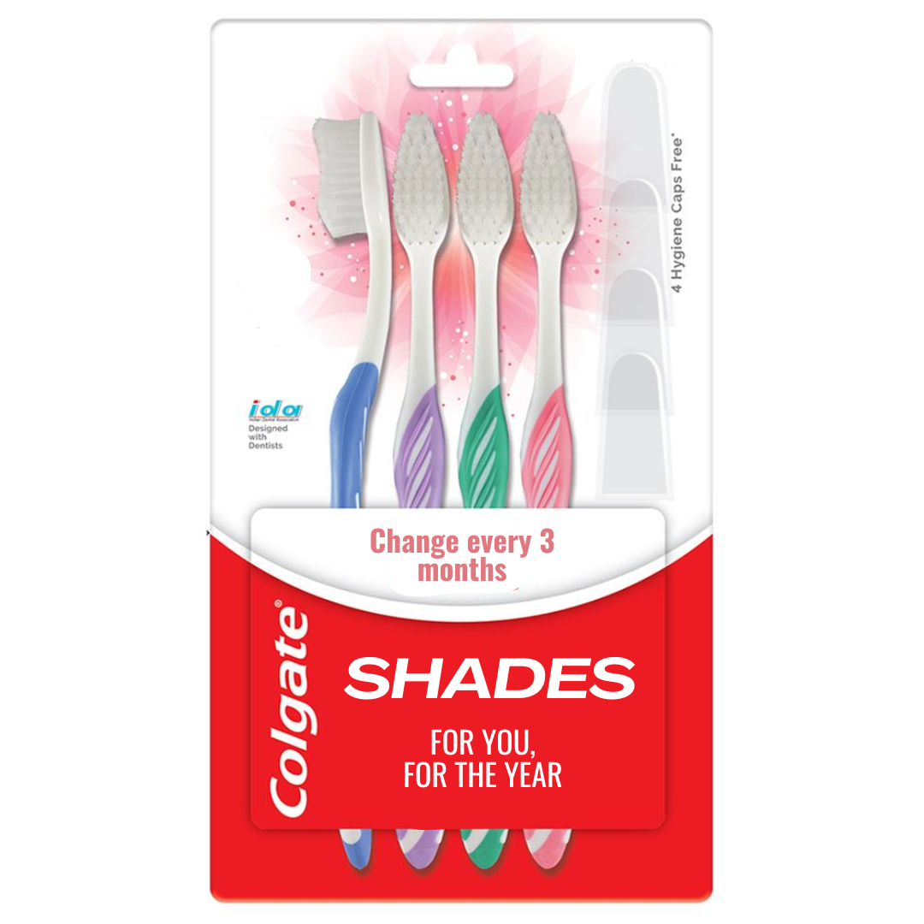
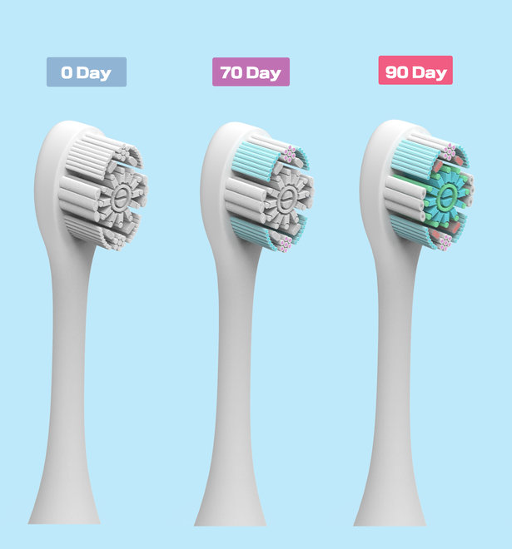
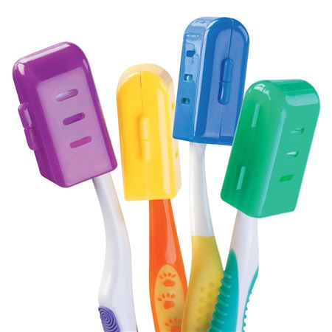
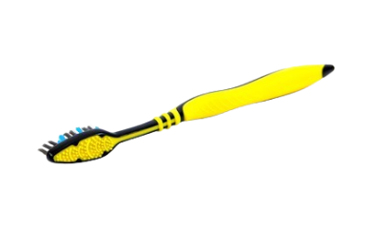


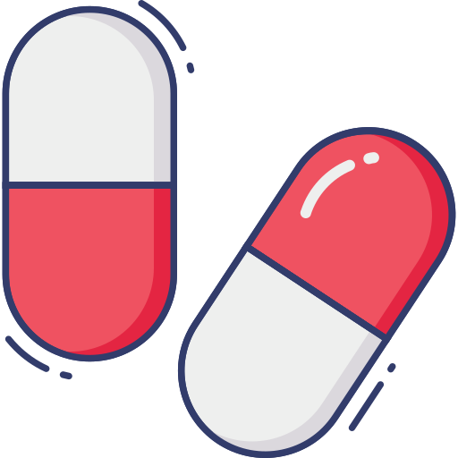
The product follows the narrative change through creation of external stimulus…
Behaviour change through
1. Narrative change
2. Product innovation
Product features
A MORE INTUITIVE REMINDER OF THE USER TO REPLACE THE TOOTHBRUSH REGULARLY AT 3 MONTHS
Product attributes
Pack of 4 toothbrush, Colgate SHADES emphasizing the changing colour feature, associating the colour with ‘time for change’. At a price point (25 Rs) to make it accessible for all
A toothbrush for every 3 months. Brushes marked 0-3, 3-6, 6-9, 9-12 for easy reminder
SEARCH
Reinforce the need for using 4 brushes throughout the year through personal packaging- not meant for family sharing
“For you, For the year”
Colour changing soft bristles to gradually build in the association of bristle health with gum health. Communicate that used brush has microbes and bacteria build up
EXPERIENCE
Make the toothbrush caps 4 different colours to remind for replacement & cleanliness
Year-long complete protection.
Trust of the brand. Colgate living up to promise of ensuring healthier gum
CREDENCE
Reinforcement for individual use
Suggestive images
BADAL DALO
Engraving the tagline “BADAL DALO” at the back of the toothbrush to reinforce the habit of changing the brush regularly
TECHNOLOGY
Toothbrush contain filaments that release a dye, and thus change color, in response to increased use of the filament.
Breuer et al., U.S. Pat. No. 4,802,255
The change in color provides a means for monitoring the degree of wear of the toothbrush
Including capsules or microspheres in the tuft holes in which the bristles of a toothbrush are mounted.
Kent, U.S. Pat. No. 5,061,106
Works as a sensory reminder every time you brush
Problem statement
Consumer insights
Rationale
Narrative change
Product innovation
Communication strategy
Points of purchase
Key financials

Slide 7
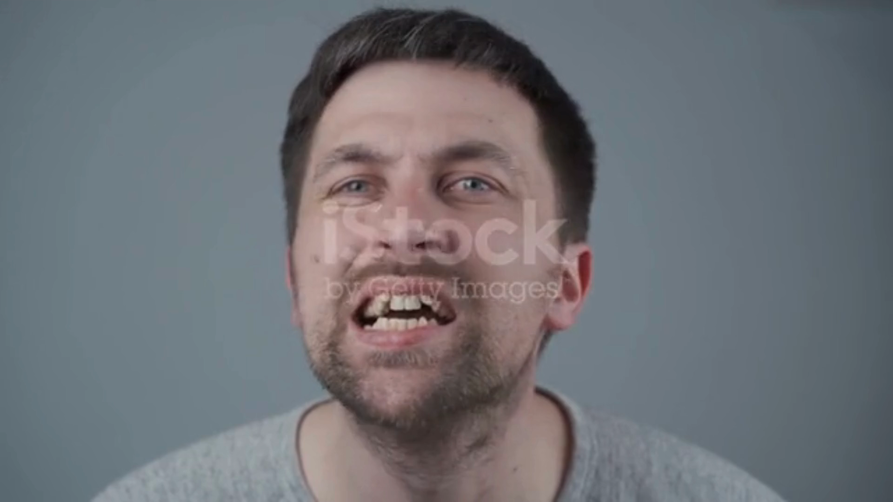


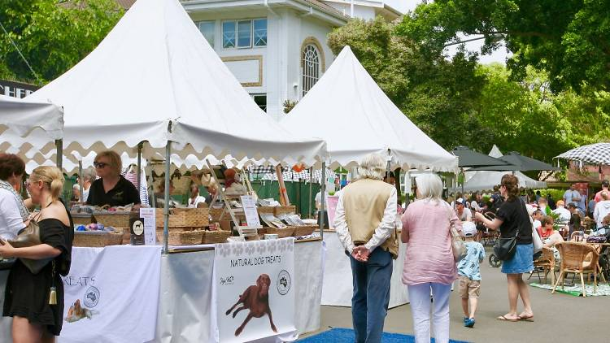
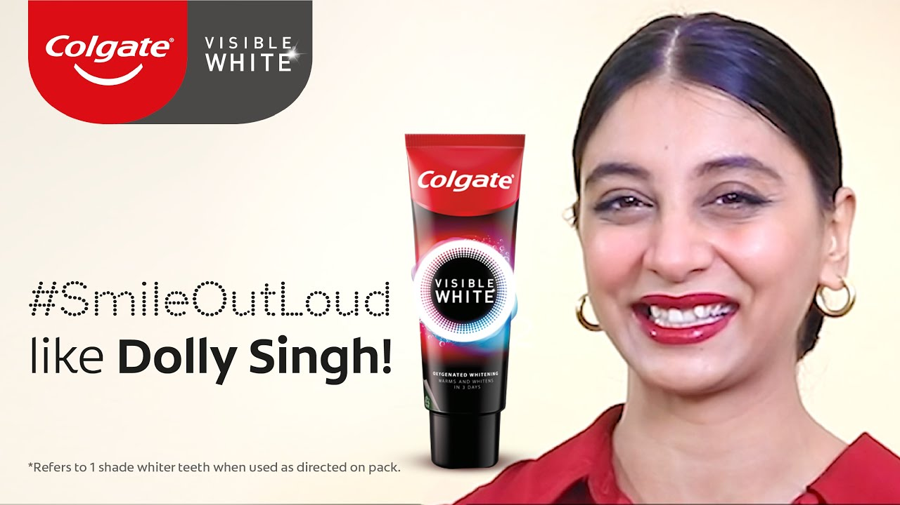

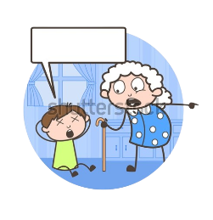
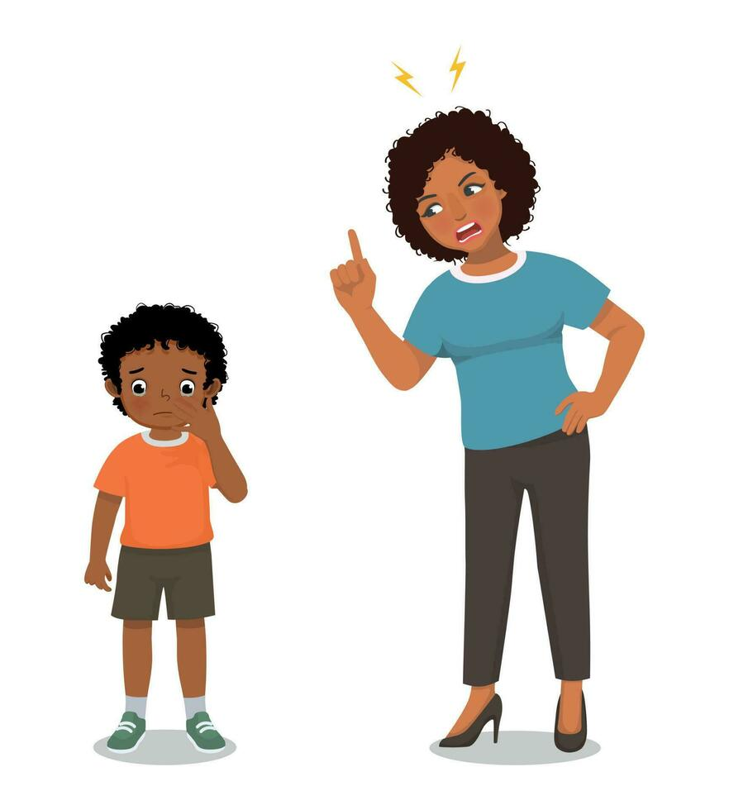

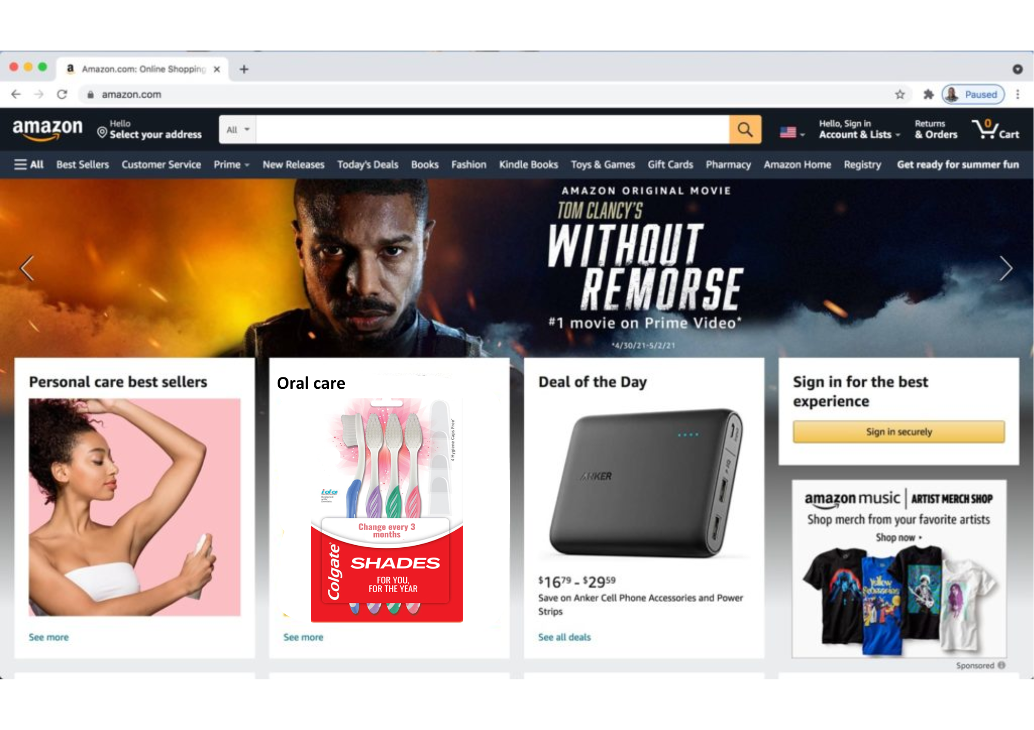


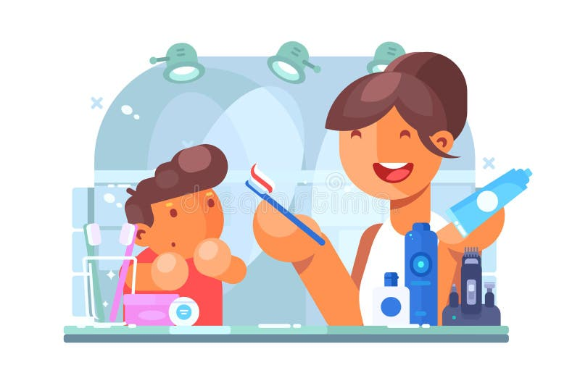
The product-specific communication strategies are made to specific target urban & rural segments….
Communication strategy for Colgate SHADES
High impact in urban sector
While the marketing schemes for Colgate SHADES will be applicable for all regions, certain promotions might be more effective in certain market segments
High impact in rural sector
Make it a self-care norm
WHO
In-serial promotion
WHO
Make the habit of replacing toothbrush regularly a self-care habit
Higher end users
Promote the product through TV shows by showing the actors use it
TV watchers
WHY
WHY
Behaviour change
High engagement
Instagram promotion
WHO
#BRUSH IT OFF
Create engagement through users sending in their “fidgety brushing” stories to get featured on the official Colgate handle
Social media users
#Mahine 3, Naya Brush in
Edu. Stalls at fairs
WHO
WHY
1,2 ka 4
4,2 ka 1
4 tak mat ja
3 pe ruk ja
Set up stalls/booths at local village fairs or melas to introduce and demonstrate the new toothbrush
Rural users
Create higher engagement
WHY
Educate consumers
Social media influencers
WHO
Collab with social media influencers already associated with Colgate to promote oral health & place SHADES as the leader
Young adults
WHY
Ad mock-up: appealing to consumer emotion
High influence
Mother scolding her son for asking a new toothbrush- she says the old one is fine
The lady now scolds even her grandson when he complains of bleeding gums & asks for a new brush
QR code inside the pack
Offer cashback on select transactions
Targeted e-commerce ads
WHO
Ask for consumers’ no. to rule out legal issues
Online purchasers
From that date, send monthly reminders
BADAL DALO not only the toothbrush, but also generational oppression- appeal to emotion
Increase visibility of the product on the website
The mother stops her & gives her son a new Colgate SHADE toothbrush, thus breaking the generational oppression
WHY
Easy & quick access
Rationale: MASS REACH- an app that everyone uses
Problem statement
Consumer insights
Rationale
Narrative change
Product innovation
Communication strategy
Points of purchase
Key financials

Slide 8

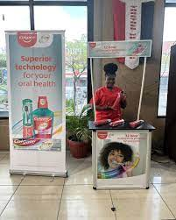
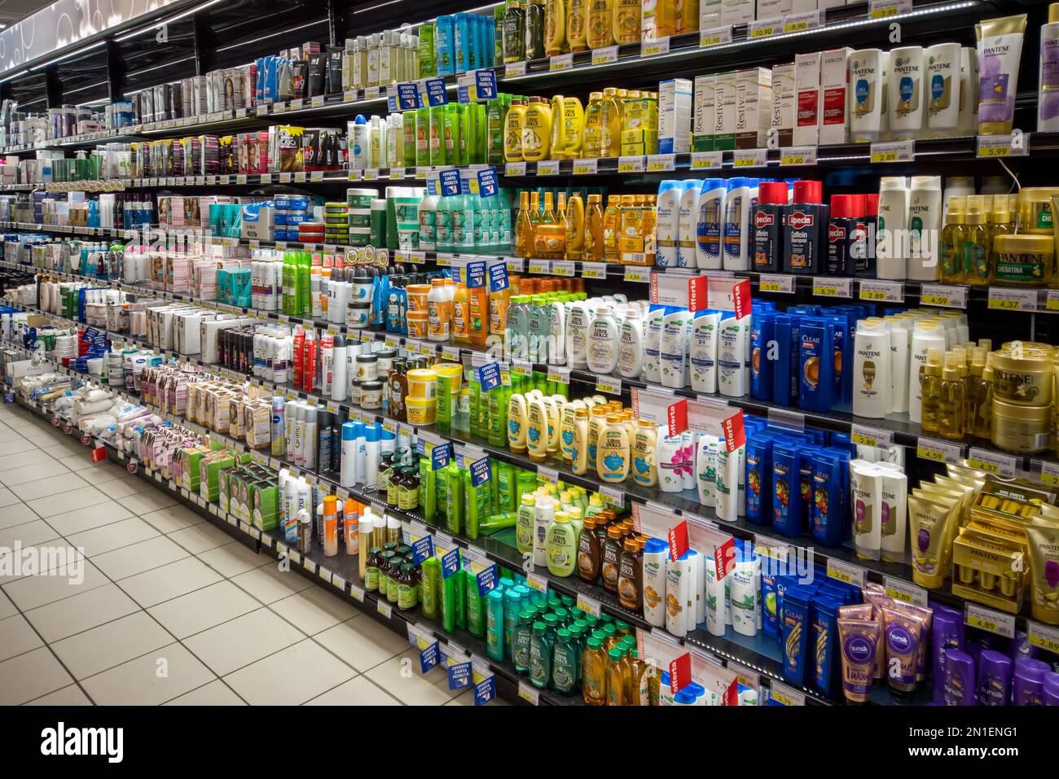
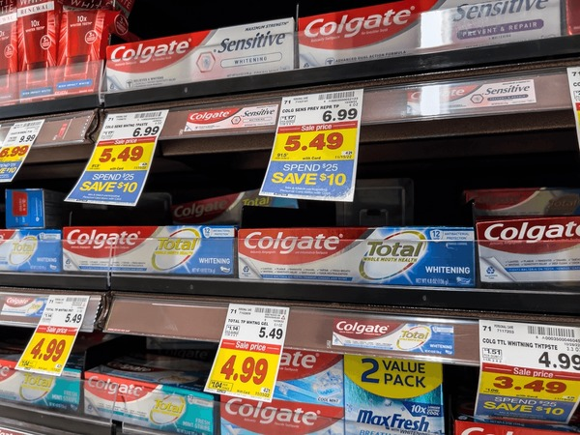

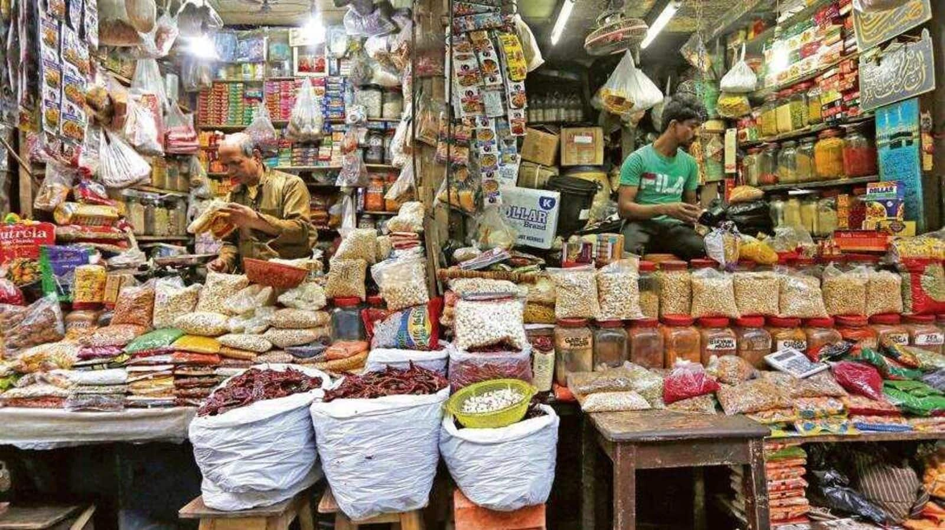
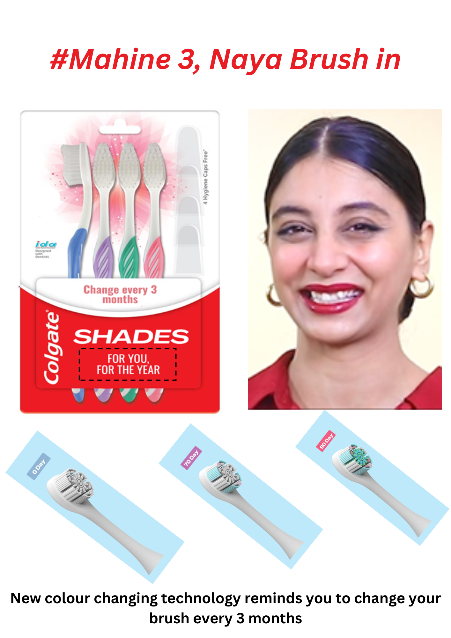



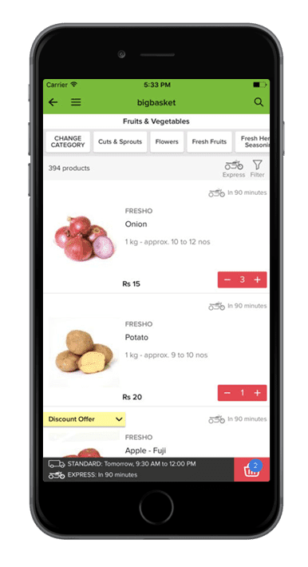
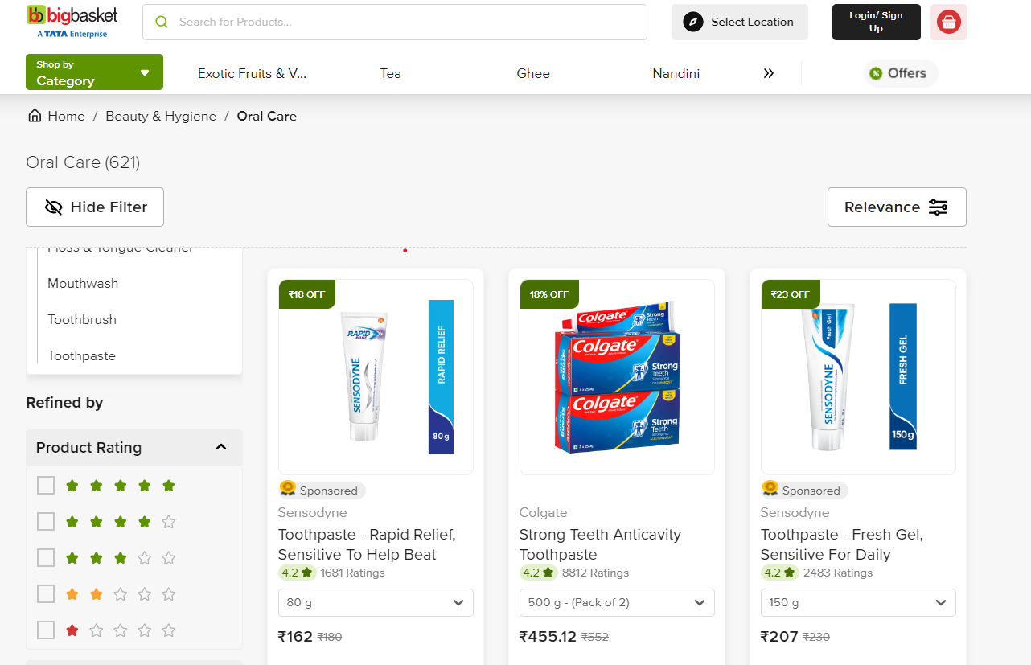

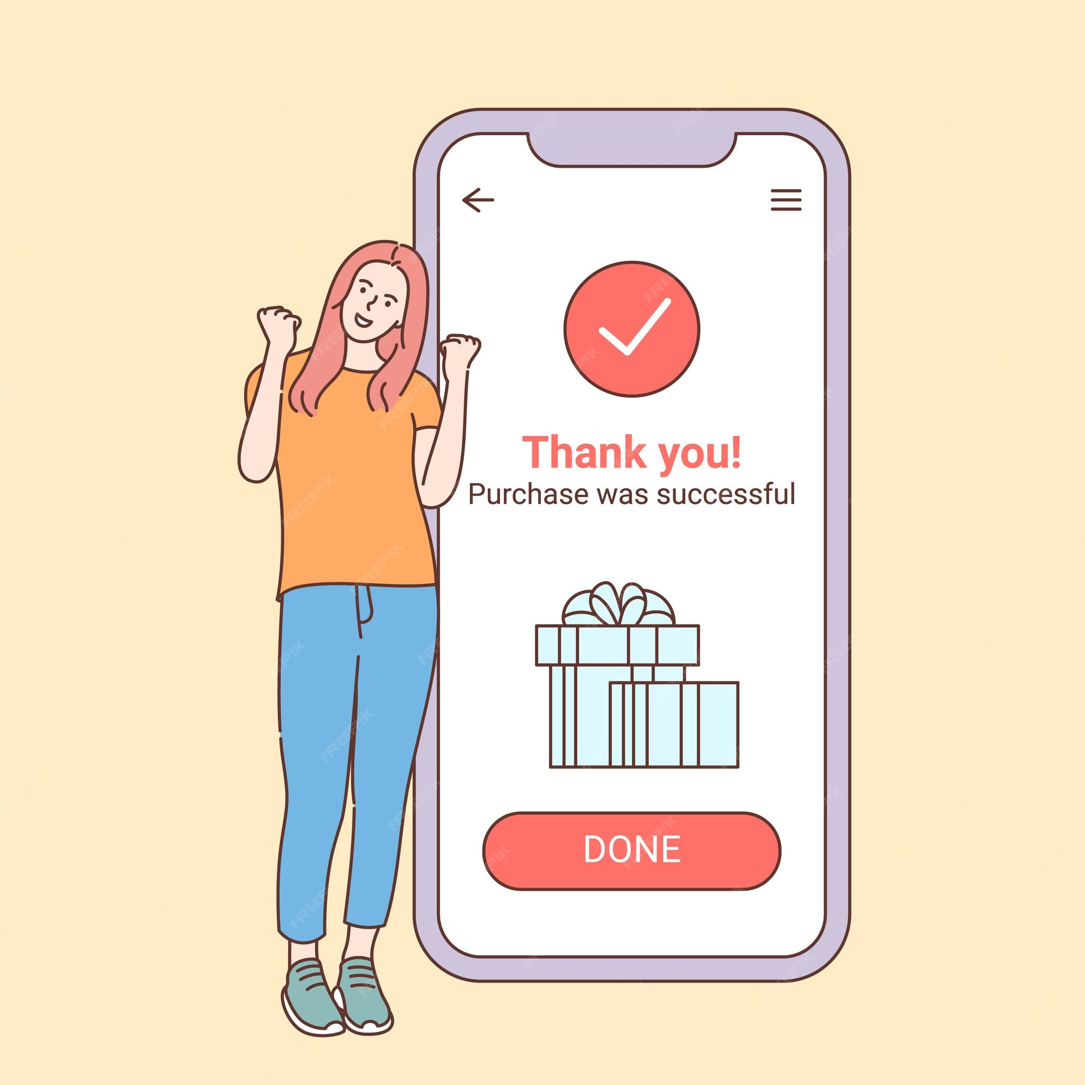
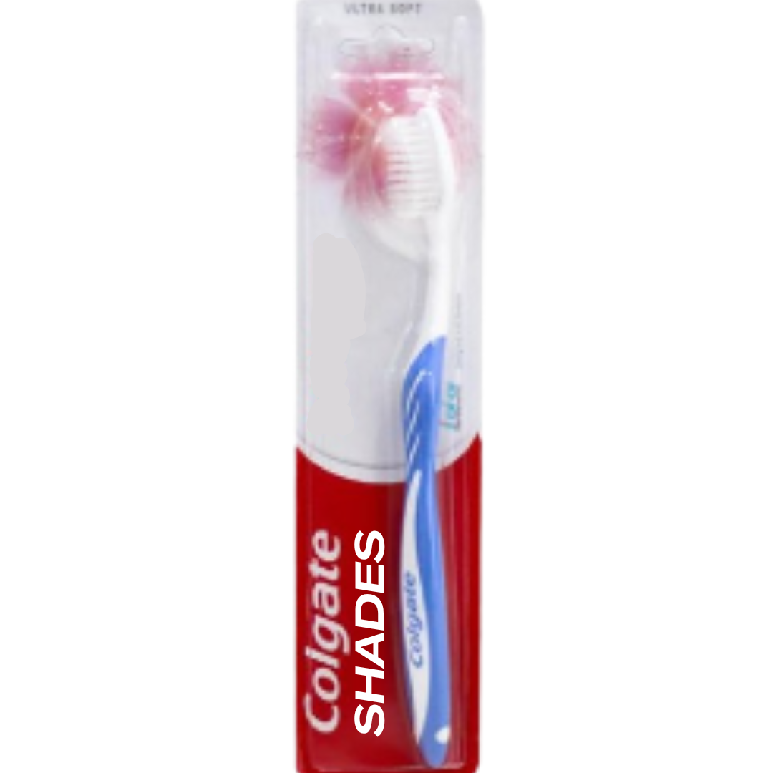

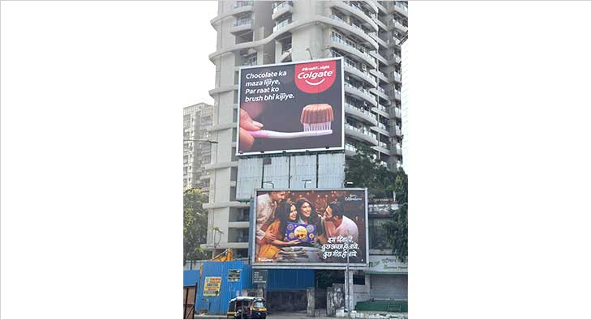
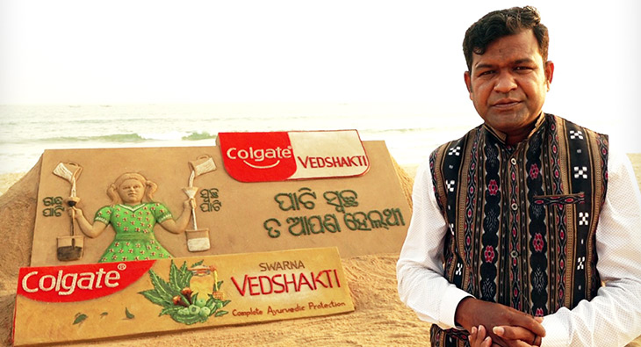
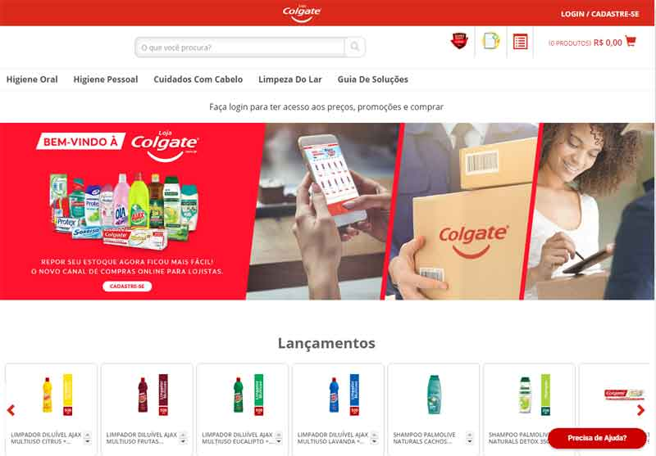
Making Colgate SHADES visible across various points of purchase with different strategy in rural
Buyer buying process
Promotion in semi urban and rural India
Single SKU instead of the 4 pack ones
Modern trade
Using product bundling. One toothbrush free on the purchase of 4 toothbrush
Rita visits SPENCERs for grocery shopping
At entry point sees Colgate SHADES signage
Navigates to personal care aisle
COLGATE SHADES present at eye level
Decides to purchase
Generating awareness is key here. Spillover effect from the urban market will help penetrate
Local kirana
Increasing accessibility and affordability based on trust is the principle
Ashwin visits local kirana, has run out if soap.
Sees Colgate shades posters hanging
Enquires about the same from salesperson
Knows about new product from trusted brand
Decides to purchase
Single SKU for easier availability and sales & distribution in the rural markets
Quick commerce
Ayesha has left her toothbrush at home
Visits bigbasket
Colgate shades appears on top in personal care
Finds positive customer reviews, good offer as well
Decides to purchase
With the already high penetration of Colgate as a brand, the availability of Points of Purchase is high in both urban & rural markets, with our product increasing scope for e-commerce visibility
Advertising the new product at purchase points
Current promotion at POPs
Problem statement
Consumer insights
Rationale
Narrative change
Product innovation
Communication strategy
Points of purchase
Key financials

Slide 9
Calculations show the product launch can achieve break even in just 2 years…
KEY ASSUMPTIONS
Feasibility matrix
Urban young mothers
Urban youth
Campaign Type ​ | Cost* (Cr)​ | Reach | Feasibility | Impact
Tinder Campaign​ | 2.3​ | Low | High | Medium
Flo campaign​ | 1.9​ | Medium | High | High
Crooked hook activation​ | 6.1​ | Medium | Low | Medium
Instagram Campaign​ | 8.0​ | High | High | High
ATL/BTL​ | 8.0​ | High | Medium | High
Total ​ | 26.3​
25-39 age
TAM=1.6cr
Pop=16.9
15-24 age
TAM=30%
Pop=2.5cr
Urban Young Mothers
Key Assumption | Age 25-39
Population 25-29 | 58mil
Population 30-34 | 58mil
Population 35-39 | 53mil
Total Population | 16.9Cr
Urban Mothers | 5.9cr
With Children | 5.3cr
With relevant incomes | 1.60cr
Urban Youth
Key Assumption | Age 15-24
% of Total Population in this age segment | 17%
Population in this segment | 8.33
People in the relevant income segment | 30%
Total Population | 2.5
Key highlights
Revenue of Colgate SHADES
~50%
Current mkt. share
40%
Assumption of TAM
40%
Tipping point
12%
Price for pack of 4
.
Rs. 130
Mark. Cost as % of rev (in line with existing biz)
2
Time ​ | Y1​ | Y2​ | Y3​ | Y4​ | Y5​
Target Share​ | 1%​ | 4%​ | 8%​ | 15%​ | 20%​
Milestones​ | Pilot in Different Metro cities - Mumbai and Delhi​ | Full scale implementation across Metros, Pilots in Tier-1 Cities ​ | Full scale implementation in Tier 1, Pilot in Tier-2​ | Implementation across Tier-1,2&3 Cities​ | Increasing share across different cities, potential entry into villages​
Years to break even
Profits in cr.
50
Problem statement
Consumer insights
Rationale
Narrative change
Product innovation
Communication strategy
Points of purchase
Key financials

Slide 10
APPENDIX

Slide 11
1,2 ka 4
4,2 ka 1
4 tak mat ja
3 pe ruk ja
#Mahine 3, Naya Brush in
BADAL DAALO
Product theme
Awareness theme
Campaign theme
+
[expert opinion]
Crooked hook challenge
Blank billboard for curiosity
Mystery QR

Slide 12
Video for enforcing behaviour change as social-norm
Product promotion through Instagram
Increasing visibility in e-commerce
Consumer insight video
Promotion at brick-and-mortar stores
Proposed product

